Slide 1




SpeeDT Database
CEF 440 : PROGRAMMING AND MOBILE PROGRAMMING
Task 6: Database Design and Implementation
GROUP 4
Course Instructor Dr. Nkemeni Valery
University of Buea Faculty of Engineering and Technology

Slide 2






What We Will Cover
1. Data Elements
2. Conceptual Design
The fields the system needs to store, across four entities
Chen ER notation showing entities, relationships and attributes
3. ER Diagram
4. Database Implementation
Tables, columns, data types, primary and foreign keys
SQL schema, constraints, and indexes on PostgreSQL / Neon DB
5. Backend Implementation
6. Connecting Database to Backend
Node.js + Express layered architecture and REST API endpoints
Connection pooling, request lifecycle, and live SQL queries

Slide 3


Why a Strong Database Layer Matters
I N T R O D U C T I O N
SpeeDT is a crowdsensing application that collects mobile network quality data from everyday smartphone users across Cameroon.
Our Task 2 survey found that 94% of respondents experience network problems regularly, and MTN was used by over 83% of respondents.
94%
experience network problems
83%
use MTN as their operator
4
database tables
10
REST API endpoints
Task 6 builds the persistent data layer that makes all of this possible: storing measurements reliably, querying them efficiently, and connecting every part of the system together.

Slide 4


01
Data Elements
Identifying every field the system needs to store, across four entities

Slide 5






Four Entities, Four Data Categories
D A T A E L E M E N T S
Each table groups a related set of fields derived from the SRS functional requirements.
Subscriber Device
Network Metric
Location
Feedback
Device metadata, consent flags, and user preferences. The anonymous_id UUID is the hub linking all other tables.
One timestamped snapshot of network conditions, collected roughly every 60 seconds by the background service.
GPS readings linked to a device, enabling coverage mapping. Kept separate so tracking can be toggled independently.
Subjective QoE star ratings submitted by users, optionally linked to the metric reading that triggered them.
anonymous_id · device_model · os · consent_given · registered_at
network_type · signal_strength_dbm
· download_mbps · latency_ms
latitude · longitude · location_name · recorded_at
overall_rating · speed_rating · delay_rating · comment

Slide 6
network_metric: The Core Measurement Table
D A T A E L E M E N T S D E E P D I V E
This table receives one new row roughly every 60 seconds from every active device.
Field | Data Type | Description
metric_id | SERIAL | Auto-incremented integer that uniquely identifies each reading
anonymous_id | UUID | Foreign key linking this metric to the device that recorded it
network_type | TEXT | 2G, 3G, 4G LTE, 5G, or WiFi
operator_name | TEXT | MTN, Orange, or CAMTEL
signal_strength_dbm | INTEGER | Signal strength in dBm closer to 0 means stronger
download_mbps | NUMERIC(8,2) | Measured download throughput
upload_mbps | NUMERIC(8,2) | Measured upload throughput
latency_ms | NUMERIC(8,2) | Round-trip ping time
jitter_ms | NUMERIC(8,2) | Variability in latency indicates connection stability
packet_loss_pct | NUMERIC(5,2) | Percentage of packets lost in transmission
recorded_at | TIMESTAMPTZ | Timestamp of the measurement

Slide 7
02
Conceptual Design
Entities, relationships, and attributes in Chen ER notation

Slide 8
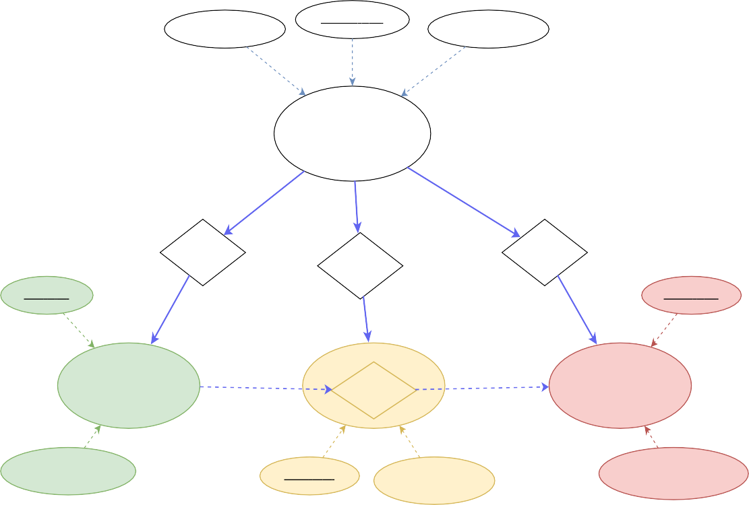
Entities and How They Relate
C O N C E P T U A L D E S I G N
SpeeDT Conceptual Data Model
SUBSCRIBER_DEVICE → generates → NETWORK_METRIC
1 : N
consent_given, registered_at
anonymous_id (PK)
device_model, os, app_version
SUBSCRIBER_DEVICE → records → LOCATION
1 : N
SUBSCRIBER_DEVICE
₁ 1
1
SUBSCRIBER_DEVICE → submits → FEEDBACK
1 : N
generates
records
submits
metric_id (PK)
feedback_id (PK)
NETWORK_METRIC → linked to (optional) → FEEDBACK
1 : 0..1
N
N
N
NETWORK_METRIC 1
^{LO}lin^{C}ke^{A}d^{T}to^{I}.^{O}.. ^{N}
0..1
FEEDBACK
Design Decisions
ignal_strength_dbm, download_mbps, up...
location_id (PK)
latitude, longitude, location_name...
overall_rating, speed_rating, delay_rating...
Privacy-first identifiers
Text is not SVG - cannot display
a UUID replaces phone number / IMEI to satisfy NFR-07.
Append-only measurement tables
metrics and locations are never updated, only inserted.
Figure 1 Conceptual Data Model (Chen ER Notation)

Slide 9
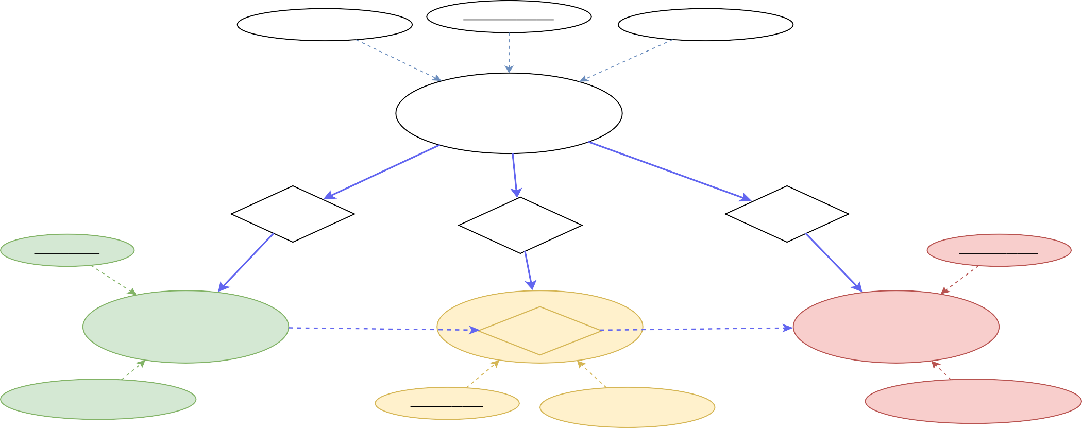
C O N C E P T U A L D E S I G N
Full Conceptual Data Model
Drawn in Chen ER notation ellipses are entities, diamonds are relationships, small dashed ellipses are attributes.
SpeeDT
Conceptual Data Model
consent_given, registered_at
anonymous_id (PK)
device_model, os, app_version
SUBSCRIBER_DEVICE
1
1
1
generates
records
submits
metric_id (PK)
feedback_id (PK)
N
N
N
NETWORK_METRIC
1
^{LO}lin^{C}ke^{A}d^{T}to^{I}.^{O}.. ^{N}
0..1
FEEDBACK
ignal_strength_dbm, download_mbps, up...
location_id (PK)
latitude, longitude, location_name...
overall_rating, speed_rating, delay_rating...
Text is not SVG - cannot display

Slide 10
03
ER Diagram
Tables, columns, data types, and key relationships

Slide 11
How to Read the Diagram
E R D I A G R A M
Entity-Relationship Diagram SpeeDT Database
SUBSCRIBER_DEVICE |  |  |  | FEEDBACK
PK | anonymous_id | UUID · DEFAULT gen_random_uuid() · PRIMARY KEY |  | PK | feedback_id | SERIAL PRIMARY KEY
PK | anonymous_id | UUID · DEFAULT gen_random_uuid() · PRIMARY KEY |  | FK | anonymous_id | UUID → subscriber_device
 |  |  | 1 : N 1 : N 1 : 0..1
 | device_model | TEXT NOT NULL |  | FK | metric_id (nullable) | INT → network_metric
 | os | TEXT NOT NULL
 |  |  |  |  | overall_rating | INTEGER CHECK (1-5)
 | app_version | TEXT NOT NULL
 |  |  |  |  | speed_rating | INTEGER CHECK (1-5)
 | consent_given | BOOLEAN DEFAULT FALSE
 |  |  |  |  | delay_rating | INTEGER CHECK (1-5)
 | data_collection_enabled data_collection_enabled | BOOLEAN DEFAULT TRUE BOOLEAN DEFAULT TRUE
 |  |  |  |  | reliability_rating | INTEGER CHECK (1-5)
 |  |  |  |  | comment | TEXT (optional)
 | wifi_only_uploads | BOOLEAN DEFAULT FALSE
 |  |  |  |  | submitted_at | TIMESTAMPTZ DEFAULT NOW()
 | notifications_enabled | BOOLEAN DEFAULT FALSE
 | registered_at | TIMESTAMPTZ DEFAULT NOW()
PK
Primary Key the unique identifier for each row
FK
Foreign Key references the primary key of another table
FK?
Optional Foreign Key the column can be null
1 : N
NETWORK_METRIC
PK | metric_id | SERIAL PRIMARY KEY
FK | anonymous_id | UUID → subscriber_device
 | network_type | TEXT NOT NULL
 | operator_name | TEXT
 | signal_strength_dbm | INTEGER
 | download_mbps | NUMERIC(8,2)
 | upload_mbps | NUMERIC(8,2)
 | latency_ms | NUMERIC(8,2)
 | jitter_ms | NUMERIC(8,2)
 | packet_loss_pct | NUMERIC(5,2)
 | recorded_at | TIMESTAMPTZ DEFAULT NOW()
LOCATION
PK | location_id | SERIAL PRIMARY KEY
FK | anonymous_id | UUID → subscriber_device
 | latitude | DOUBLE PRECISION NOT NULL
 | longitude | DOUBLE PRECISION NOT NULL
 | location_name | TEXT
 | recorded_at | TIMESTAMPTZ DEFAULT NOW()
1 : N
One record links to many records in the related table
1 : 0..1
One record links to zero or one related record (optional)
Legend...
Referential Integrity
Text is not SVG - cannot display
subscriber_device → CASCADE: deleting a device deletes all its related records. network_metric.metric_id → SET NULL: deleting a metric clears the feedback link only.

Slide 12
E R D I A G R A M
Entity-Relationship Diagram SpeeDT Database
Entity-Relationship Diagram SpeeDT Database
SUBSCRIBER_DEVICE
FEEDBACK
PK
anonymous_id
UUID · DEFAULT gen_random_uuid() · PRIMARY KEY
PK
feedback_id
SERIAL PRIMARY KEY
PK
anonymous_id
UUID · DEFAULT gen_random_uuid() · PRIMARY KEY
1 : N
FK
anonymous_id
UUID → subscriber_device
device_model
TEXT NOT NULL
FK
metric_id (nullable)
INT → network_metric
os
TEXT NOT NULL
overall_rating
INTEGER CHECK (1-5)
app_version
TEXT NOT NULL
speed_rating
INTEGER CHECK (1-5)
consent_given
BOOLEAN DEFAULT FALSE
delay_rating
INTEGER CHECK (1-5)
data_collection_enabled data_collection_enabled
BOOLEAN DEFAULT TRUE BOOLEAN DEFAULT TRUE
reliability_rating
INTEGER CHECK (1-5)
wifi_only_uploads
BOOLEAN DEFAULT FALSE
1 : N
comment
TEXT (optional)
notifications_enabled
BOOLEAN DEFAULT FALSE
1 : 0..1
submitted_at
TIMESTAMPTZ DEFAULT NOW()
registered_at
TIMESTAMPTZ DEFAULT NOW()
1 : N
NETWORK_METRIC
LOCATION
PK | location_id | SERIAL PRIMARY KEY
FK | anonymous_id | UUID → subscriber_device
 | latitude | DOUBLE PRECISION NOT NULL
 | longitude | DOUBLE PRECISION NOT NULL
 | location_name | TEXT
 | recorded_at | TIMESTAMPTZ DEFAULT NOW()
PK
metric_id
SERIAL PRIMARY KEY
FK
anonymous_id
UUID → subscriber_device
network_type
TEXT NOT NULL
operator_name
TEXT
signal_strength_dbm
INTEGER
download_mbps
NUMERIC(8,2)
upload_mbps
NUMERIC(8,2)
latency_ms
NUMERIC(8,2)
jitter_ms
NUMERIC(8,2)
packet_loss_pct
NUMERIC(5,2)
Legend...
recorded_at
TIMESTAMPTZ DEFAULT NOW()
Text is not SVG - cannot display

Slide 13
04
Database Implementation
SQL schema, constraints, and indexes on PostgreSQL / Neon DB

Slide 14




Why PostgreSQL on Neon DB
D A T A B A S E I M P L E M E N T A T I O N
PostgreSQL 16
Neon DB
Open-source, ACID-compliant relational database. Supports UUID keys, TIMESTAMPTZ, and the pgcrypto extension.
Serverless cloud host for PostgreSQL. Free tier, automatic scaling, no infrastructure to manage.
pgcrypto Extension
SSL / TLS
Provides gen_random_uuid(), used as the DEFAULT value for every
device anonymous_id.
All connections to Neon DB are encrypted in transit, enforced by
sslmode=require.

Slide 15
Creating the subscriber_device Table
D A T A B A S E I M P L E M E N T A T I O N
CREATE EXTENSION IF NOT EXISTS "pgcrypto";
CREATE TABLE subscriber_device (
anonymous_id | UUID | PRIMARY KEY DEFAULT gen_random_uuid(),
device_model | TEXT | NOT NULL,
os | TEXT | NOT NULL,
app_version | TEXT | NOT NULL,
consent_given | BOOLEAN | DEFAULT FALSE,
data_collection_enabled | BOOLEAN | DEFAULT TRUE,
wifi_only_uploads | BOOLEAN | DEFAULT FALSE,
notifications_enabled | BOOLEAN | DEFAULT FALSE,
registered_at | TIMESTAMPTZ | DEFAULT NOW()
);
anonymous_id defaults to gen_random_uuid() generated automatically, never supplied by the client.

Slide 16
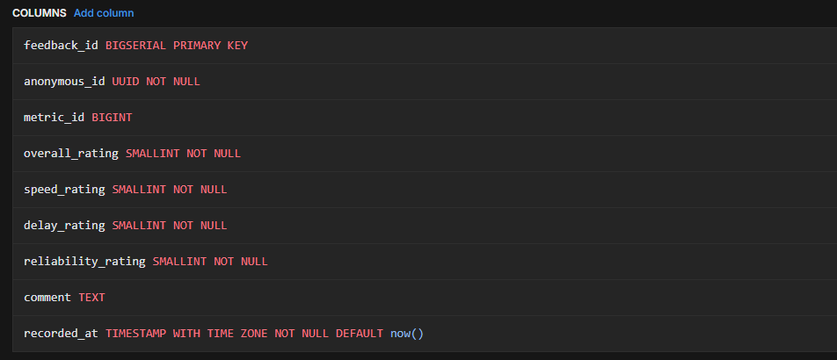
Creating the Feedback Table
D A T A B A S E I M P L E M E N T A T I O N
CREATE EXTENSION IF NOT EXISTS "pgcrypto";
CREATE TABLE subscriber_device (
anonymous_id | UUID | PRIMARY KEY DEFAULT gen_random_uuid(),
device_model | TEXT | NOT NULL,
os | TEXT | NOT NULL,
app_version | TEXT | NOT NULL,
consent_given | BOOLEAN | DEFAULT FALSE,
data_collection_enabled | BOOLEAN | DEFAULT TRUE,
wifi_only_uploads | BOOLEAN | DEFAULT FALSE,
notifications_enabled | BOOLEAN | DEFAULT FALSE,
registered_at | TIMESTAMPTZ | DEFAULT NOW()
);
anonymous_id defaults to gen_random_uuid() generated automatically, never supplied by the client.

Slide 17
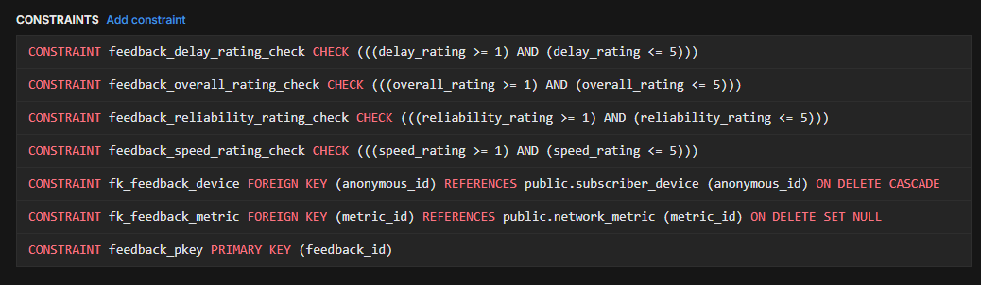
Feedback Table Constraints
D A T A B A S E I M P L E M E N T A T I O N
CREATE EXTENSION IF NOT EXISTS "pgcrypto";
CREATE TABLE subscriber_device (
anonymous_id | UUID | PRIMARY KEY DEFAULT gen_random_uuid(),
device_model | TEXT | NOT NULL,
os | TEXT | NOT NULL,
app_version | TEXT | NOT NULL,
consent_given | BOOLEAN | DEFAULT FALSE,
data_collection_enabled | BOOLEAN | DEFAULT TRUE,
wifi_only_uploads | BOOLEAN | DEFAULT FALSE,
notifications_enabled | BOOLEAN | DEFAULT FALSE,
registered_at | TIMESTAMPTZ | DEFAULT NOW()
);

Slide 18
Constraints and Indexes
D A T A B A S E I M P L E M E N T A T I O N
Foreign Keys & Cascades
Indexes for Performance
Parent Table | ON DELETE Rule | Effect
subscriber_device | CASCADE | Deleting a device deletes all related metrics, locations, and feedback
network_metric (metric_id) | SET NULL | Deleting a metric keeps feedback but clears the link
CREATE INDEX idx_metric_anonymous_id ON network_metric(anonymous_id);
CREATE INDEX idx_metric_recorded_at
ON network_metric(recorded_at DESC);
CHECK Constraints
CREATE INDEX idx_location_anonymous_id ON location(anonymous_id);
CHECK (overall_rating BETWEEN 1 AND 5)
Applied to all four feedback rating columns. The database rejects out-of-range values even if application validation is bypassed.
CREATE INDEX idx_feedback_anonymous_id ON feedback(anonymous_id);

Slide 19
05
Backend Implementation
Node.js + Express layered architecture and REST API

Slide 20
B A C K E N D I M P L E M E N T A T I O N
Layered Architecture
Each layer has exactly one job routes, validation, controllers, services, and the database config.
Backend Layered Architecture SpeeDT QoE Backend
Mobile Application (SpeeDT React Native / Expo)...
CLIENT
Express.js Application (src/app.js)...
ROUTING
Validation Middleware (src/middleware/validation.js)...
MIDDLEWARE
Controllers (src/controllers/)...
calls
Services (src/services/)...
LOGIC
DATA ACCESS
PostgreSQL on Neon DB (src/config/db.js)...
Error Handler...
.env file...
Text is not SVG - cannot di splay

Slide 21
10 REST API Endpoints
B A C K E N D I M P L E M E N T A T I O N
Method | Endpoint | Description
POST | /api/devices | Register a new device; returns generated anonymous_id
GET | /api/devices/:deviceId | Retrieve a registered device by UUID
POST | /api/metrics | Ingest a new network metric reading
GET | /api/metrics/latest/:deviceId | Get the most recent metric for a device
POST | /api/locations | Record a new GPS location entry
GET | /api/locations/history/:deviceId | Get full location history for a device
POST | /api/feedback | Submit a QoE feedback rating
GET | /api/analytics/average-speed/:deviceId | Average download / upload speed for a device
GET | /api/analytics/average-qoe/:deviceId | Average values across all four rating dimensions

Slide 22
Validation Middleware
B A C K E N D I M P L E M E N T A T I O N
Every request passes through three checks before reaching the controller.
1
Required Field Check
Rejects requests missing mandatory body fields with HTTP 400.
const isValidUUID = (value) => { const uuidRegex =
/^[0-9a-f]{8}-[0-9a-f]{4}-
[1-5][0-9a-f]{3}-[89ab]
[0-9a-f]{3}-[0-9a-f]{12}$/i;
return typeof value === 'string' && uuidRegex.test(value.trim());
};
2
UUID Sanitization
Strips stray angle brackets pasted from documentation, e.g. <device-id>.
3
UUID Format Validation
Verifies the anonymous_id matches the RFC 4122 UUID format via regex.

Slide 23
06
Connecting Database to Backend
Connection pooling, the request lifecycle, and live SQL queries

Slide 24
API Request Lifecycle
C O N N E C T I N G D A T A B A S E T O B A C K E N D
Tracing one POST /api/metrics request from the mobile app to PostgreSQL and back.
API Request Lifecycle POST /api/metrics
1. Mobile App...
2. Express Router...
3. Validation...
4. Controller...
5. Service...
6. PostgreSQL (Neon DB)...
invalid
All traffic over TLS / SSL
response
7. HTTP 201 Response...
Error Handler...
Text is not SVG - cannot display

Slide 25
The Connection Pool src/config/db.js
C O N N E C T I N G D A T A B A S E T O B A C K E N D
const { Pool } = require('pg'); require('dotenv').config();
const pool = new Pool({
connectionString: process.env.DATABASE_URL,
ssl: { rejectUnauthorized: false },
});
const initDatabase = async () => { await pool.query(
'CREATE EXTENSION IF NOT EXISTS "pgcrypto";'
);
console.log('Connected to Neon DB.');
};
module.exports = { pool, initDatabase };
A connection pool reuses open connections instead of opening a new one for every request.

Slide 26
Service Layer Parameterized Queries
C O N N E C T I N G D A T A B A S E T O B A C K E N D
$1, $2, $3...
Placeholders filled separately from the SQL text this prevents SQL injection.
const { pool } = require('../config/db');
const ingestMetric = async (data) => {
const query = `
INSERT INTO network_metric ( anonymous_id, network_type, download_mbps, latency_ms
) VALUES ($1, $2, $3, $4) RETURNING *
`;
const result = await pool.query( query,
[data.anonymous_id, data.network_type, data.download_mbps, data.latency_ms]
);
return result.rows[0];
};
RETURNING *
Sends back the full inserted row, including DB-generated fields like metric_id and recorded_at.
pool.query()
Borrows a connection, runs the query, returns the connection to the pool automatically.

Slide 27
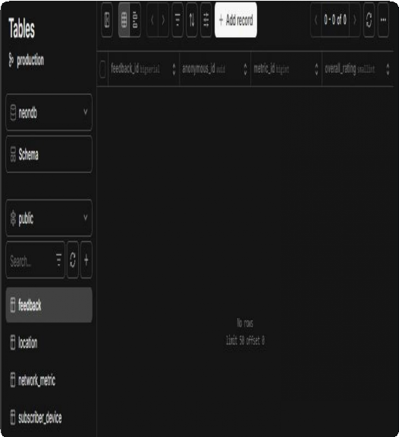
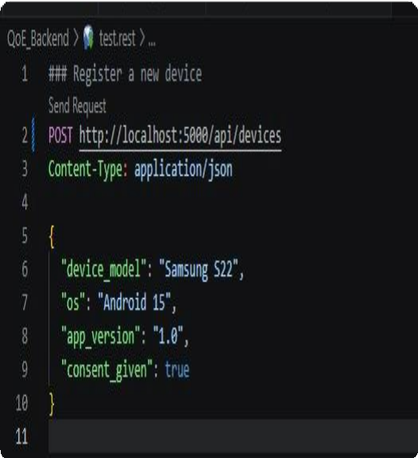
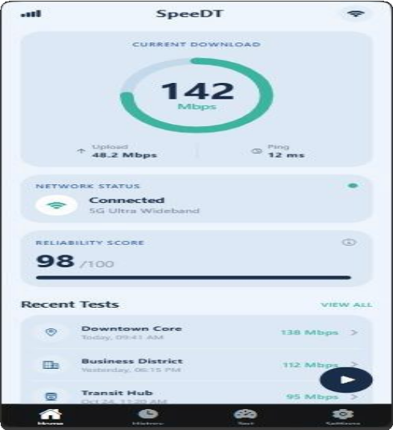
Database in Action
L I V E D E M O N S T R A T I O N
Screenshots from the working system replace the placeholders below with your own captures.
Neon DB Console Tables
Postman / REST Client API Test
Mobile App Live Dashboard

Slide 28
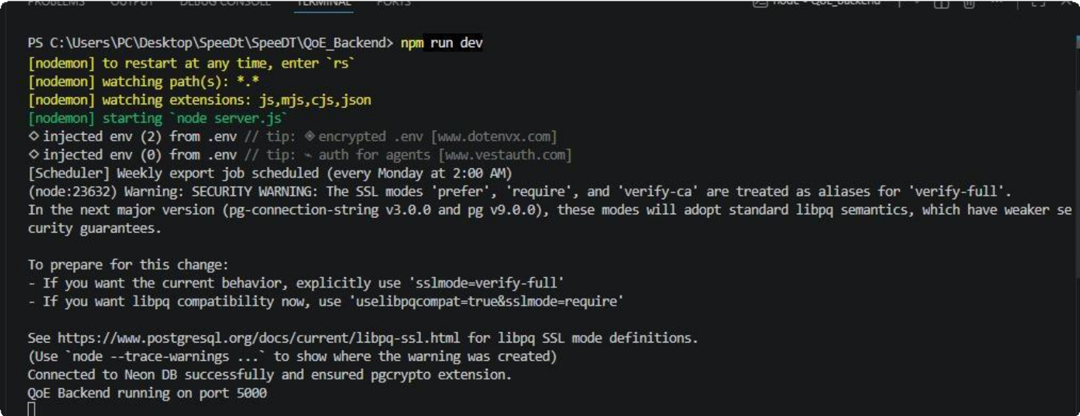
Backend Running in the Terminal
L I V E D E M O N S T R A T I O N
Add a screenshot of the server starting up, or VS Code with the project structure open.

Slide 29



Key Takeaways
S U M M A R Y
Four-table schema
subscriber_device, network_metric, location, and feedback cover all SRS functional requirements.
Privacy by design
UUID-based anonymous_id replaces personal identifiers, satisfying NFR-07.
Layered backend
Routes → Validation → Controllers → Services → Database, each with
one responsibility.
Secure by default
Parameterized SQL queries and TLS-encrypted connections to Neon
DB throughout.

Slide 30



Thank You

